Slide 1
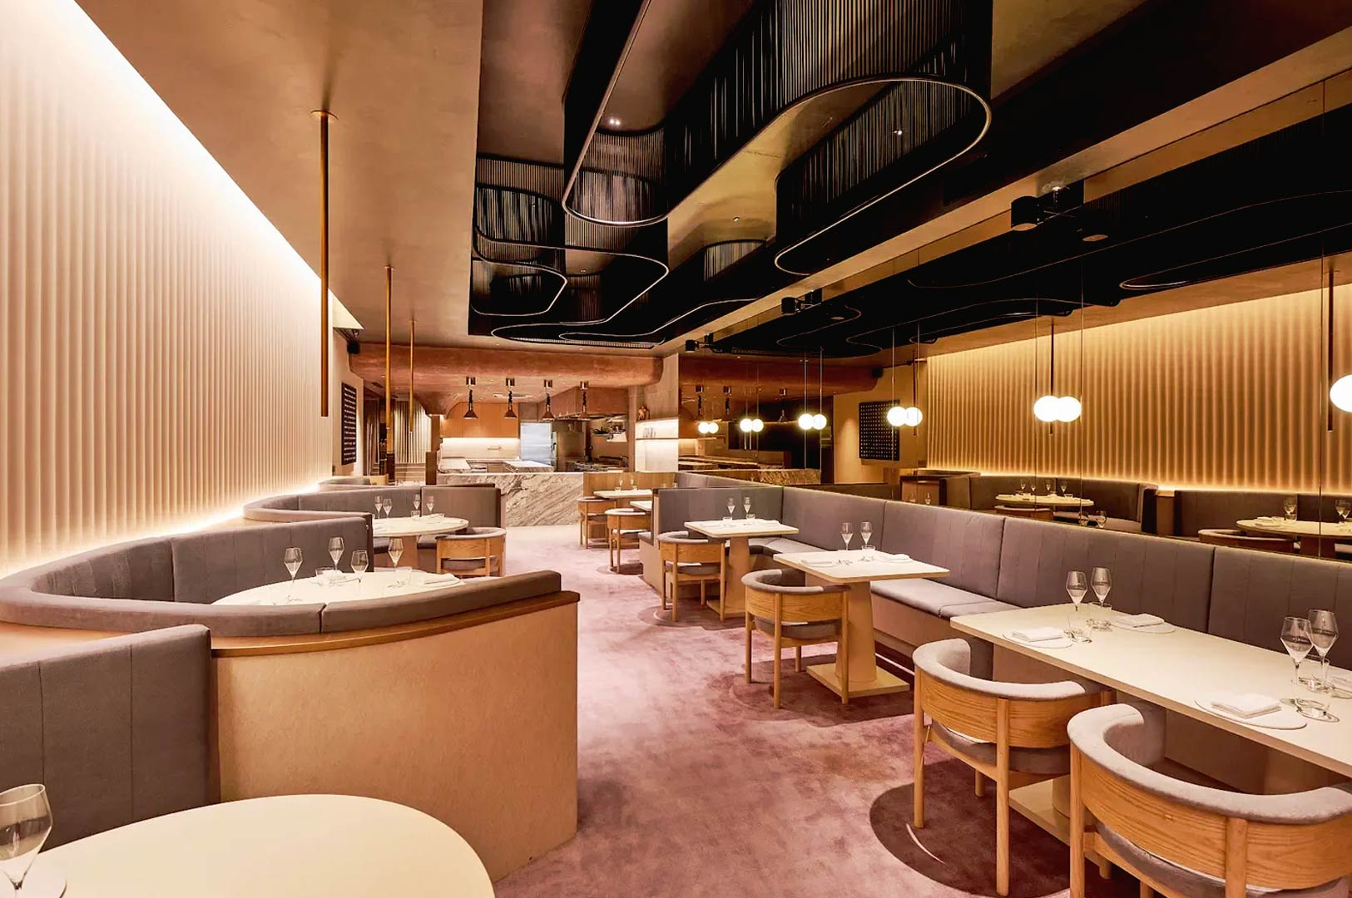



Lahori Dhabba
OOP CONCEPTS IN C++
Traditional Pakistani Restaurant
Restaurant Management System
Abstraction
Encapsulation
Inheritance
Polymorphism
Operator Overloading
Demonstrating Object-Oriented Programming in a Real-World Application
PRESENTED BY
Syed Hammad Hassan (ID: 45440)
CO-PRESENTER
Abdul Rauf (ID: 47576)

Slide 2
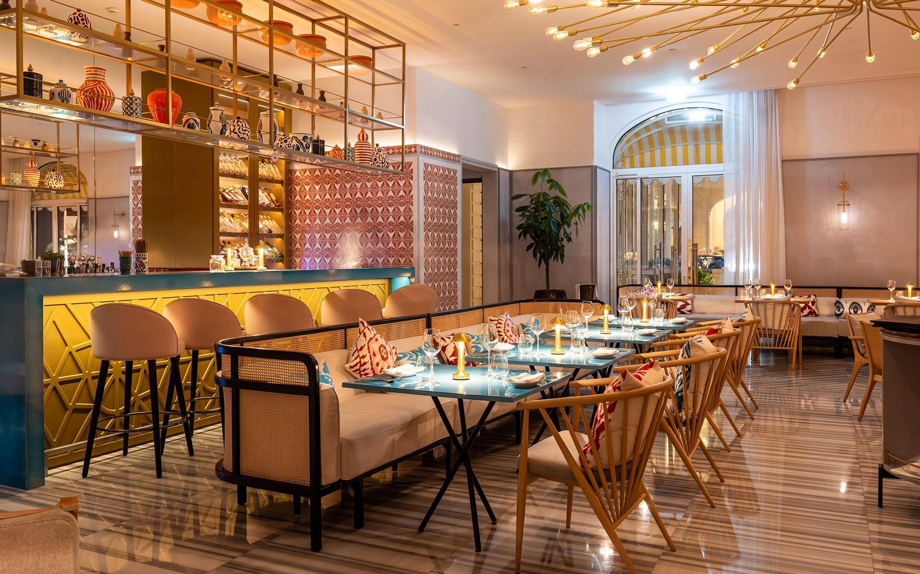


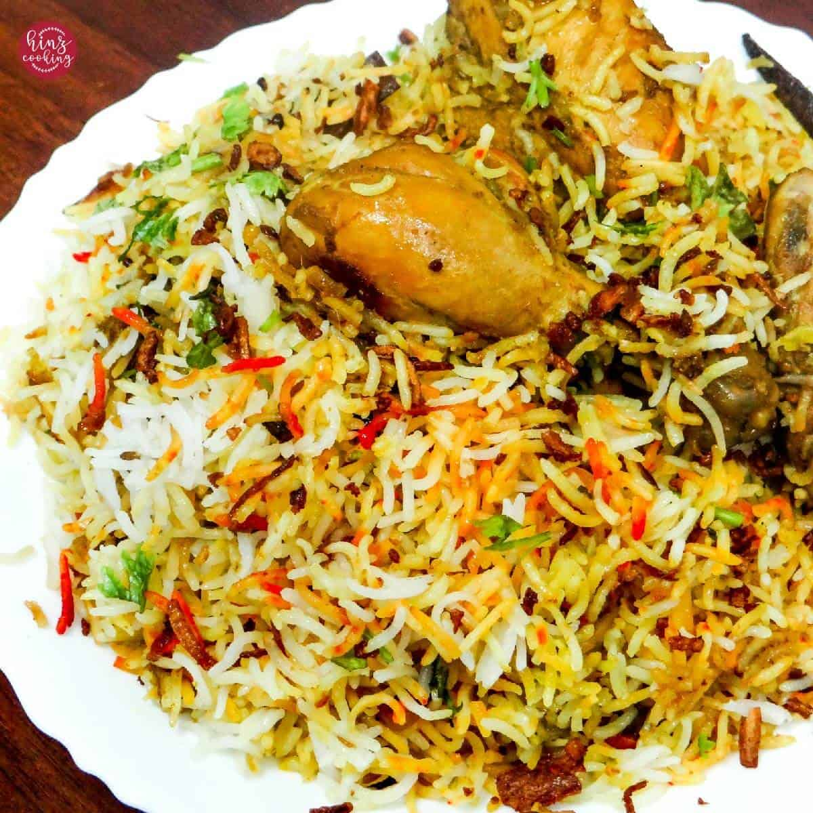


Restaurant Management System
Overview and Purpose
What is the System?
A C++ software that manages restaurant operations using Object-Oriented Programming principles.
Key Features
• Restaurant & branch management
• Staff hierarchy tracking
• Menu item creation & combos
• Order processing & billing
OOP Concepts
Abstraction
Encapsulation
Inheritance
Polymorphism
Pure Virtual Functions
Operator Overloading

Slide 3





Abstraction & Pure Virtual Functions
Hiding Implementation Details
What is Abstraction?
Hiding complex details and showing only essential features.
Key: Show "what" not "how"
Pure Virtual Functions
Forces derived classes to implement the function.
Customers see only the menu and place orders
Example: Person class defines display() = 0
Person as Abstract Class
Employee as Abstract Class
Concrete Implementations in Manager & HeadManager
Staff implements the hidden details

Slide 4



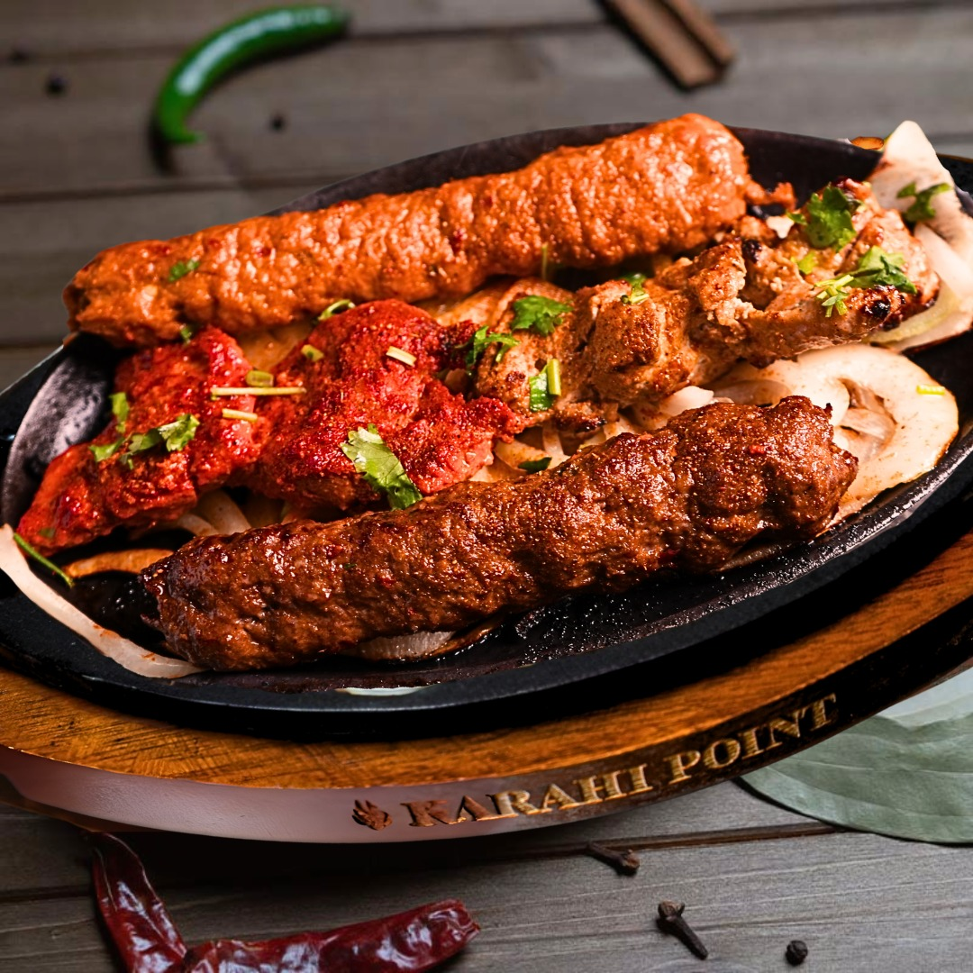






Encapsulation
Bundling Data and Methods
What is Encapsulation?
Bundling data and methods that operate on that data within a single unit.
Data Hiding
Controlled Access
Data Integrity
MenuItem encapsulates food details
Encapsulation in Our Restaurant
MenuItem: name, price, category
Customer: name, table, contact
Order: ID, amount, status
Data Protection
Maintainability
Flexibility
Each dish is an encapsulated object

Slide 5







Multilevel Inheritance
Hierarchical Class Structure
Person
Base class with name, age and pure virtual display()
Employee
Inherits from Person, adds employeeID, salary
Restaurant management hierarchy
Manager & HeadManager
Concrete classes implementing display()
Code Reusability
Logical Structure
Easy Extension
Staff levels: Person → Employee → Manager

Slide 6




Polymorphism
One Interface, Multiple Implementations
What is Polymorphism?
Same function call, different behaviors based on object type.
Key: One interface, multiple implementations
Polymorphism in Our Restaurant
display() behaves differently for Manager and HeadManager.
Different staff roles respond differently
Example: Manager shows contact info, HeadManager adds branch details
Flexible Code
Easy Extension
Dynamic Behavior
Same display() function, different outputs

Slide 7





Operator Overloading
Customizing Operator Behavior
What is Operator Overloading?
Redefining how operators work with custom types.
Intuitive Syntax
Business Logic
Consistency
Operator Overloading in Our Restaurant
Menu combos: Biryani + Kabab = Combo Deal
MenuItem + MenuItem = Combo Deal
Order + Order = Merged Bill
Natural Expression
Business Rules
Clean Code
Combining dishes with the + operator

Slide 8







How It All Works Together
Integration of OOP Concepts
Multilevel Inheritance & Polymorphism
The system creates Manager and HeadManager objects, but accesses them through Employee references. When display() is called, the program automatically determines which implementation to execute based on the actual object type.
Lahori Dhabba - Where OOP meets cuisine
Menu Operations
Individual menu items like Chicken Biryani and Seekh Kabab are created using encapsulation. The + operator is then used to combine them into a combo deal with an automatic Rs.50 discount, demonstrating operator overloading.
Create Staff Objects
Manager and HeadManager objects are instantiated using multilevel inheritance
Display Information
Order Processing
Polymorphic display() calls show appropriate information based on object type
Customer orders are created with encapsulated details. The + operator merges two orders into a combined bill, automatically joining customer names and totaling the amounts with tax calculations included.
Process Menu & Orders
Operator overloading creates combos and merges orders with business logic

Slide 9

Thank You!
Any Questions?
Restaurant Management System
Presented by:
Syed Hammad Hassan
Abdul Rauf
ID: 45440
ID: 47576

